Slide 1
SPL – PS2
C++ Memory Handling

Slide 2
PS2: Today’s Agenda
Introduction to memory model in C++
C++ Pointers
C++ Arrays
String vs Char* (c-style string)
C++ References
C++ Memory Handling
Pointers Dangers
Code
Notes:
https://www.onlinegdb.com/edit/F4iqR4m-re#

Slide 3
Memory model
Each process running on the system has its own memory space. This memory space is the range of addresses that can be described using a single word.
In this memory space, the process puts any information it needs. This includes compiled code, constants, and variable it needs.
In this course, we will focus on two “kinds” of memory available to the process. The stack and the heap.

Slide 4
Memory model
Stack: Used for static memory allocation. Every variable you declare inside a function lives on the stack. Once you leave the scope of the function, the stack variables are discarded.
Heap: Used for dynamic memory allocation. Variables allocated on the heap have their memory allocated at run time. You can allocate a block at any time and free it at any time. This makes it much more complex to keep track of which parts of the heap are allocated or free at any given time.

Slide 5
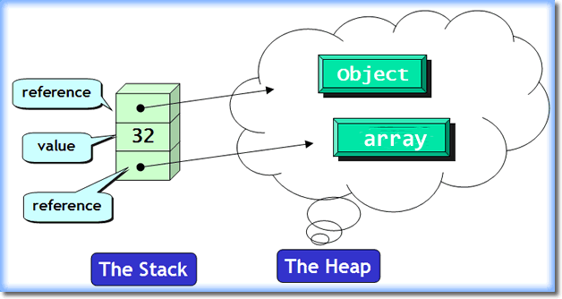
Notes:
In java

Slide 6

Java references
The actual value of the string s is on the heap; the value of the variable s is the location of this data on the heap.
Here, the variable s can hold the address of a String object on the heap, but it currently holds a null value.
In Java, primitive types are stored in the stack.

Slide 7
C++ Pointers
In C++, you have access to actual memory locations via pointers.
A pointer is a variable that points to another variable, or, more precisely, an integer holding a memory address.
Declaring a pointer is done with using the operator * before the name of the variable.
Accessing the address of a variable is done using the operator ‘&’.
int i = 2;
int* pi = &i;
cout << i << endl;
cout << pi << endl;
cout << *pi << endl;
Notes:
Showcase a void pointer, also not that one shouldn’t declare a pointer without defining it.

Slide 8
C++ Pointers
The null value in C++ is the number 0. (Memory address 0)
You can (but usually shouldn’t) assign an integer value to a pointer.
When appearing before a pointer, the ‘*’ operator means – access the value in this address.
int* p = (int*)22222;
cout << p << endl;
// cout << *p << endl; //might crash
Notes:
Assuming 23bit, draw the memory layout!

Slide 9
C++ pointers (cont)
You can also compare the value of pointers
int j = 5;
int i = 5;
int *p_j = &j; // p_j value is the address of the variable j
int *p_j2 = &j; // p_j2 value is the address of the variable j also
int *p_i = &i; // p_i value is the address of variable i
if (p_j == p_j2) { cout << "1" << endl; }
if (p_j == p_i) { cout << "2" << endl; }
if (*p_j == *p_i){ cout << "3" << endl; }

Slide 10
Pointers to Pointers
int num = 5;
int *x = &num;
int **y = &x;
double num2 = 2.5;
double* z = &num2;
cout << y << endl; // this is the memory location of x
cout << *y << endl; // this is the memory location of num
cout << **y << endl; // 5

Slide 11
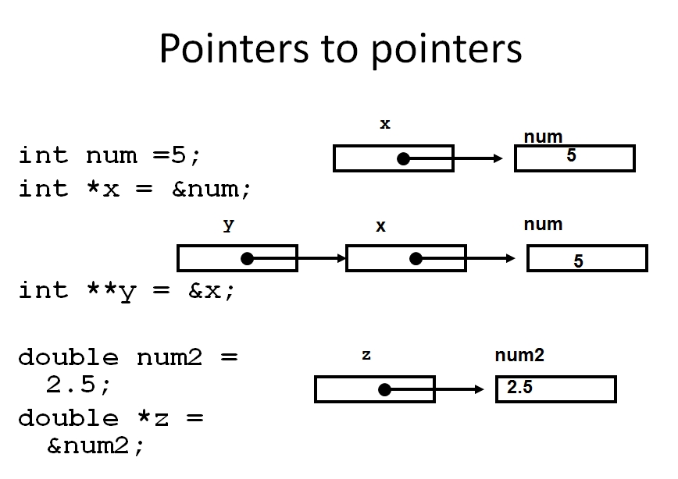
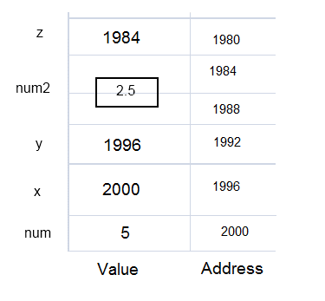
Pointers to pointers (cont)

Slide 12
Pointers to Pointers
int i = 2;
int* pi = &i;
int** ppi = &pi;
cout << &i << endl;
cout << &pi << endl;
cout << &ppi << endl;
cout << i << endl;
cout << *pi << endl;
cout << *ppi << endl;
cout << **ppi << endl;

Slide 13
Pointers Arithmetic
int i = 1;
int* pi = &i;
char* pc = (char*)&i;
double* pd = (double*)&i;
cout << *pd << endl;
pc++;
(*pc)++;
cout << i << endl;
cout << pi << endl;
pi += 1;
cout << pi << endl;
cout << pd << endl;
pd += 1;
cout << pd << endl;
A pointer is simply a number, so why do we need different kinds of pointers? (int*, char*)
  Reason 1: Type safety
  Reason 2: Pointer arithmetic
The operators ‘+’, ‘+=‘, ‘++’, ‘-’, ‘-=‘, ‘--’ are all defined to pointers.
Notes:
Use double as example

Slide 14
C++ Arrays
Arrays in C++ are const pointers.
Declaring arrays is done with the following syntax: int A[10];
In this line, a memory block big enough to hold 10 integers was allocated on the stack.
A holds the address of the start of that memory block.
Accessing an array value is done like in Java using the operator []

Slide 15
C++ Arrays
int A[10];
A[3] = 9;
int j = A[3];
In the first line, we declare an array of size 10
In the second line, we put ‘9’ in the fourth place in the array.
The second line could also be written as *(A+3)=9
The third line copies the fourth element in the array to the variable j. It could also be written as int j = *(A+3)
In C++, arrays don’t have length properties, and C++ arrays are simply pointers.
For this reason, there is no “array out of bounds” exception in C++.
int A[10];
A[100] = 9;
A[-2] = 500;

Slide 16
C++ Arrays
void arrays() {
int A[10];
int* pi = A;
cout << A << endl;
cout << pi << endl;
pi += 3;
*pi = 3;
cout << A[3] << endl;
// A[-1] = -1;
// A[100] = 100;
}

Slide 17
Using regular pointers like arrays
double A[10];
double s = 0; // just to clear size of a box
double *pi;
double j;
/* The stack at this point is depicted in the image below. */
pi = &j;
pi[3] = 5;
pi = A;
pi[3] = 5; // OK. Accessing the 4th element of A.
pi++; // now pi points to the second element of A
pi[0] = 1; // assign 1 to the second element of A.
/* Question: What will happen, if s is an int and not double */

Slide 18
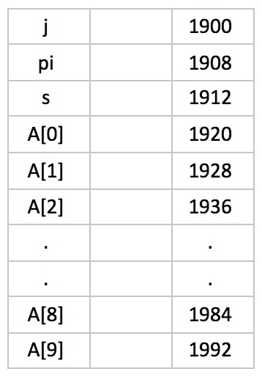
Using regular pointers like arrays (cont)

Slide 19
String vs char*
In the previous practical session, we saw the std::string object.
C++ provides another way to represent a string: an array of characters, where the last character has the value 0.
char *c = (char*)"abcdefg";
std::cout << c[3] << endl;
std::cout << &(c[3]) << endl;

Slide 20
String vs char* (cont)
You can convert between std::string and char* and back.
std::string s("abcdefg");
const char *cs = s.c_str();
The command line arguments are passed as c-strings (char*) to the main function.

Slide 21
String vs char* (cont)
string s = "string";
const char* c = s.c_str(); // dangerous...
s = "ssttrriinngg";
cout << c << endl;
cout << c[3] << endl;
cout << &(c[3]) << endl;
string s1 = string(c);
cout << s1 << endl;
Notes:
Any attempt to modify an object whose type is const-qualified results in undefined behavior.

Slide 22
C++ References
C++ supports a concept called references.
There are two types of references, lvalue and rvalue references.
An lvalue refers to an object that persists beyond a single expression.
An rvalue refers to a temporary value that does not persist beyond the expression that uses it.
ravlue cannot appear on the left side of an expression.

Slide 23
C++ references (cont)
int main(int argc, char** argv)
{
int i = 5; // i is lvalue, 5 is rvalue
int j = 4; // j is lvalue, 4 is rvalue
char *s = "test"; // s is lvalue, "test" is rvalue
j = 5 * 22; // j is lvalue, 5 * 22 is rvalue
i = i + j; // i is lvalue, i + j is rvalue
}

Slide 24
lvalue references
Behave like const pointers.
Point to a specific location that cannot be changed afterwards. Must be initialized with a real value. (Not null)
Declared using the operator & after the type.
int main(int argc, char** argv)
{
//example1:
int X = 5;
int& rX = X; // rX will hold the value 5
rX++; // rX and X will hold the value 6
//example2:
int* i = &argc;
int& j = *i; // j is a reference to int, (*i) is of type int.
std::cout << i << "," << *i << "," << j << std::endl;
// Will print: pointer address,1,1
}

Slide 25
C++ references
int i = 2;
int& ri = i;
ri++;
cout << i << endl;

Slide 26
C++ memory handling
Up until now, we have discussed allocating memory on the stack.
Allocating memory on the heap is done using the “new” operator.
“new” allocates a memory on the heap, initializes it, and returns a pointer to it.
All memory allocated with “new” must be freed, or you will get a memory leak.
Freeing memory is done using the operator “delete”

Slide 27
C++ memory handling (cont)
int *i = new int; // i points to a heap location containing 0
int *i2 = new int(2); // i2 points to a heap location containing 2
string *s = new string("I'm on the heap");
cout << "s=" << s << endl;
cout << "s=" << *s << endl;
delete s; // memory on the heap must be fr

Slide 28
Arrays on the heap
Use the new[] operator to allocate a block of memory on the heap, and delete[] to free that block.
int *A = new int[10];
int *B = A + 1;
A[0] = 1;
A[1] = 2;
B[1] = 3;
delete[] A;

Slide 29
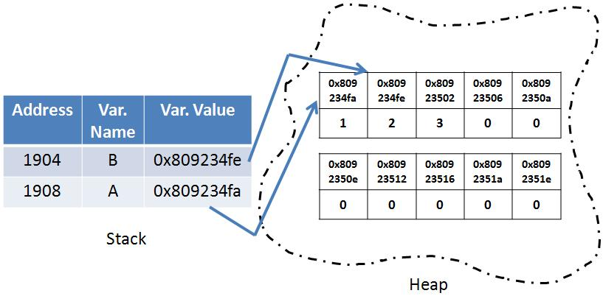
Arrays on the heap(cont)

Slide 30
2-D array on the heap.
A 2-D array is simply an array of pointers to arrays.
You can initialize it using a loop.
int** arry = new int*[rowCount];
for (int i = 0; i < rowCount; ++i)
arry[i] = new int[colCount];
Notes:
We haven’t cleaned all the memory yet!

Slide 31
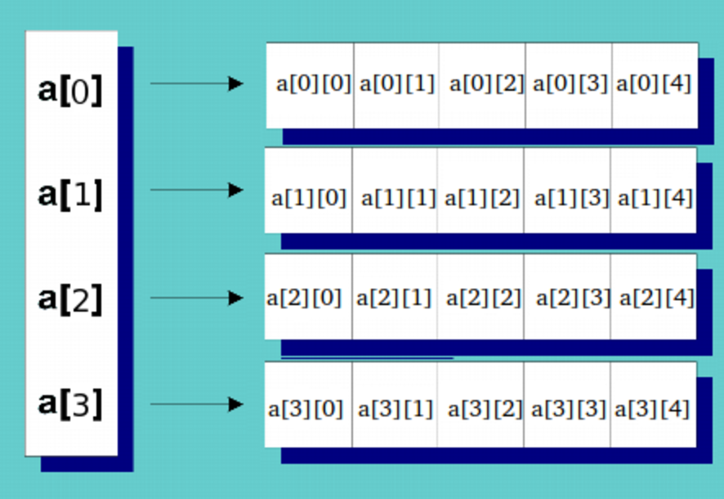
2-D arrays on the heap (cont)

Slide 32
C++ Memory handling
int* pi = new int(2);
cout << &pi << endl;
cout << pi << endl;
if (pi != nullptr) {
// safe delete
delete pi;
pi = nullptr;
}
pi = new int[10];
if (pi != nullptr) {
delete[] pi;
pi = nullptr;
}
int** arry = new int* [10];
for (int i = 0; i < 10; ++i)
arry[i] = new int[10];
for (int i = 0; i < 10; ++i)
delete arry[i];
delete[] arry;

Slide 33
Pointers Dangers
Uninitialized pointers
Dereferencing null pointers
Dereferencing a deleted pointer
int *p;
*p = 3;
int *p = nullptr;
*p = 3;
int *p = new int;
delete p;
*p = 5;

Slide 34
Pointers Dangers (cont)
Dereferencing a dangling pointer
Beware of memory leaks
Safe delete
int *p, *q;
p = new int;
q = p;
delete q;
*p = 3;
int *p = new int;
p = nullptr;
delete p;
p = nullptr;

Slide 35
Pointer Dangers
int* p;
// *p = 3; doesn't compile
p = new int;
delete p;
// *p = 5; compile
p = new int;
int* q = p;
delete q;
// *p = 3;
p = new int;
p = nullptr;

Slide 36
Further Reading
Pointer Declaration (cpp reference)
Back to Basics: Pointers and Memory - Ben Saks - CppCon 2020
Array declaration (cpp reference)
Reference declaration

